Slide 1
Improved facial emotion recognition using yolo and deepface for music suggestion
Presented by
S.SRIRAM

Slide 2
PROBLEM IDENTIFICATION
A user had to manually go through the playlist and choose
songs on older music players. Otherwise, the music is downloaded from the internet and kept on our system or
device, where it may subsequently be played by the user.
Songs may now be fast-forwarded, re-winded, and even
played by speech recognition, thanks to modern technology.
These capabilities may meet the necessary needs of the user,
still the user need to actively search through the music library and choose songs based on their mood and behavior. That is a user's urge and desire to browse through his playlist based on their mood and feelings.

Slide 3
AIM AND OBJECTIVES
The objective is to recognize the emotion of the person and start playing the music according to the specific person mood.
To test the usability, a heuristic evaluation has been performed with several users, concluding that the implemented system is more user friendly, faster and efficient- compared to existing systems.
The purpose of the system is to minimize the manual work by identifying the music through facial expression and analyzing the expression of the face using DeepFace.

Slide 4
PROPOSED METHODOLOGY
The proposed framework would work by first giving a simple scan on a live face using webcam .
Then the faces will be exposed and then it will be filtered and checked for features or properties and remove the features which are unwanted.
Then the positively filtered features are classified and analyzed. Initially the image captured by the webcam will be fed into the YOLO algorithm, that identifies only the face and displays it inside the bounding box.Then the face detected inside the bounding box will be captured and it is given as the input to the deepface algorithm.
The deepface then analyses the face captured and analyses the emotion of the person .After the emotion of the person is detected the songs will be played according to their current emotion.

Slide 5
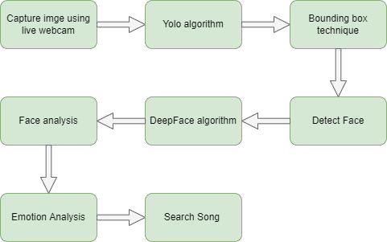
Steps..

Slide 6

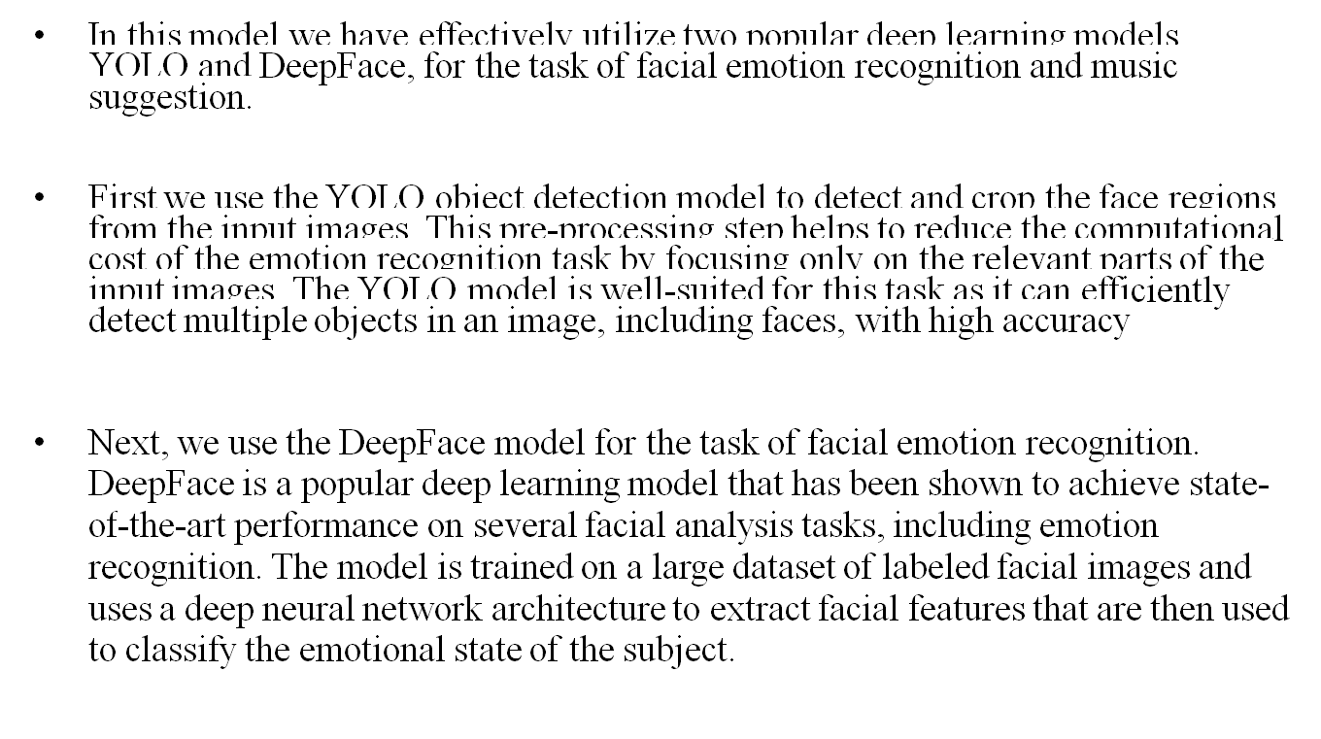

Slide 7
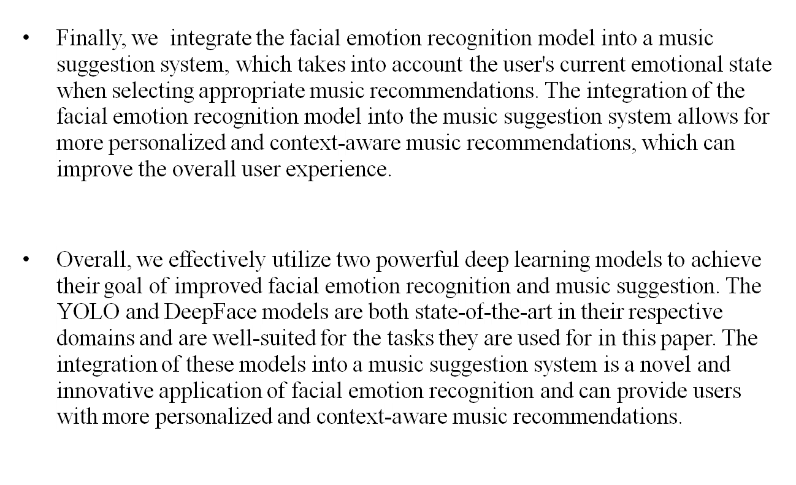

Slide 8
SCOPE OF THE PROJECT
Yoloface is capable of identifying multiple objects in the single frame or image that provides better accuracy since many object can be there in a single frame.
With the help of DeepFace process, to find the face expression deeply and makes the process faster.

Slide 9
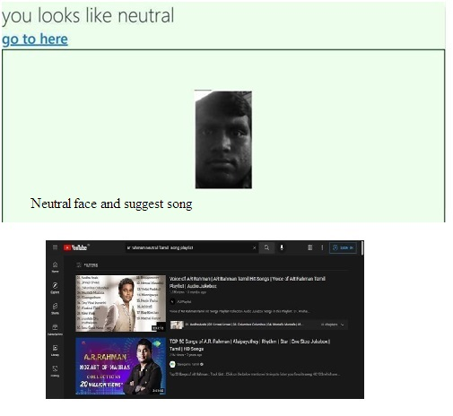
Sample outputs

Slide 10
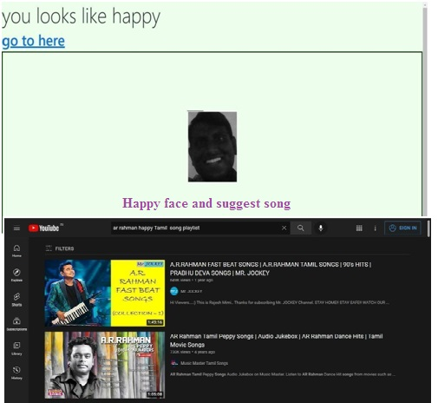

Slide 11
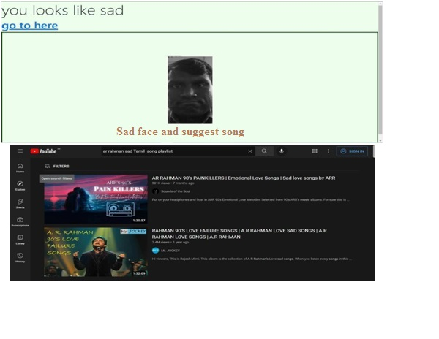

Slide 12
Thank You

